Slide 1

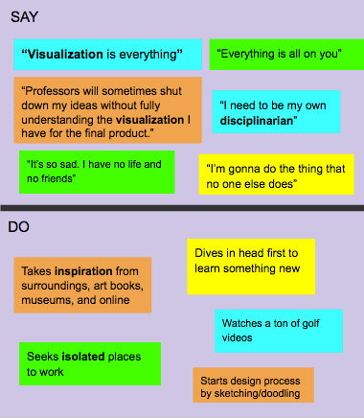
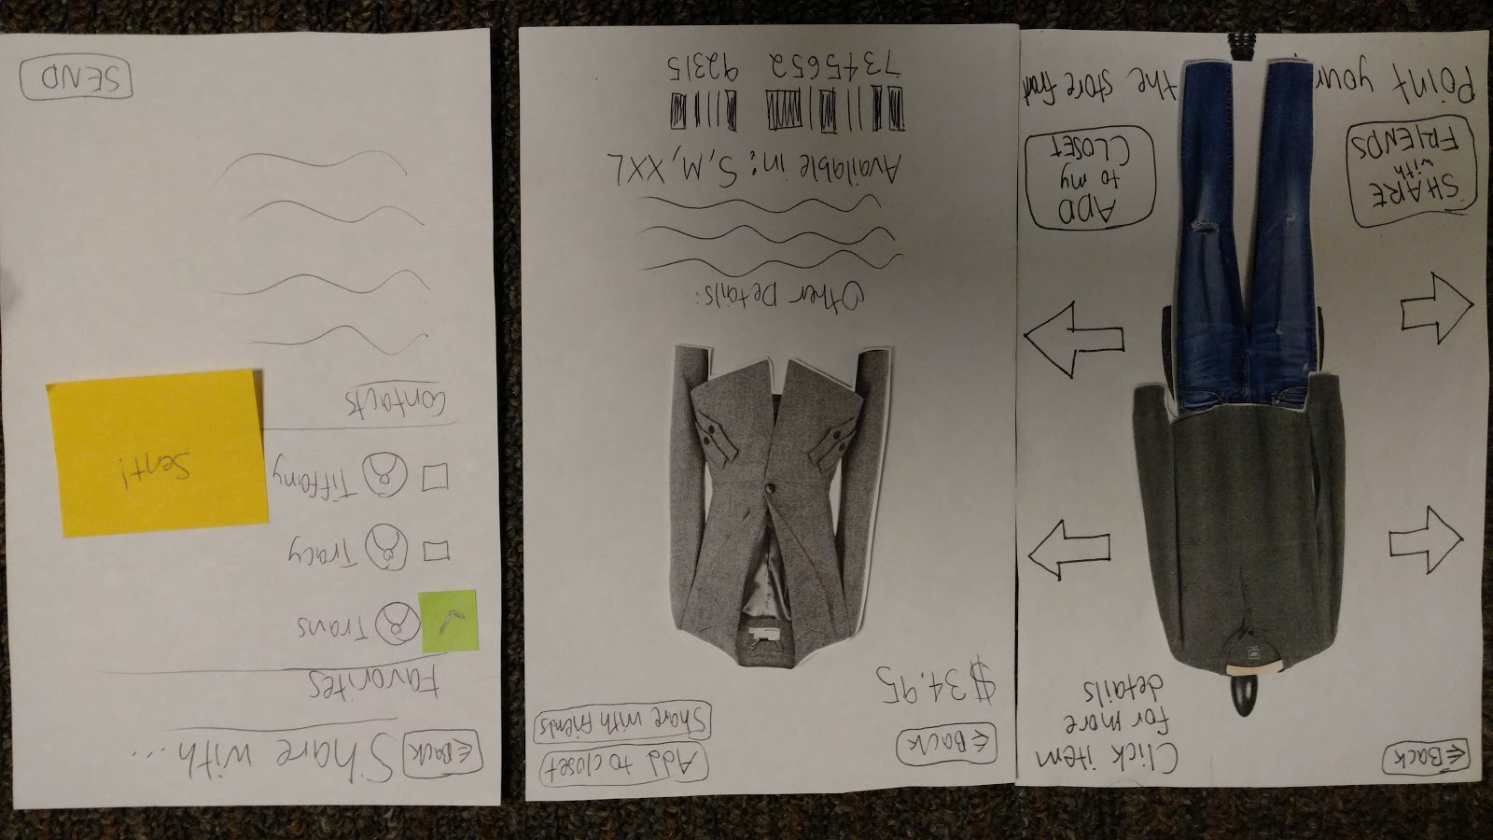
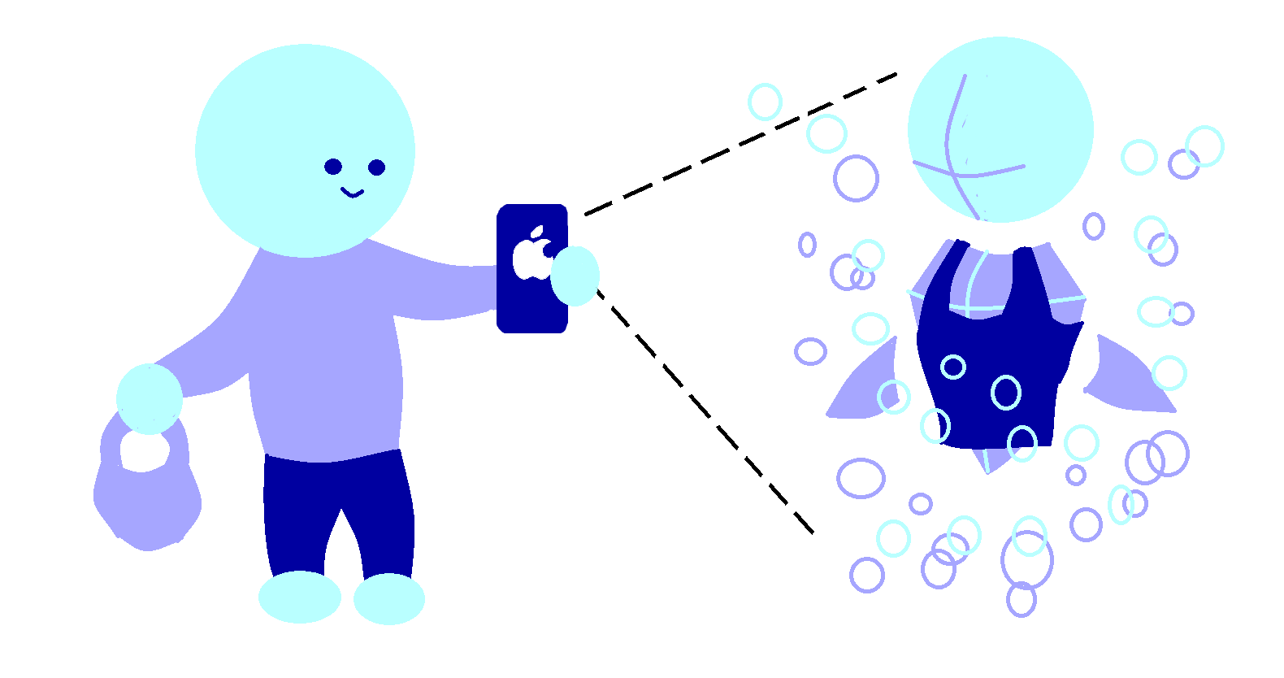

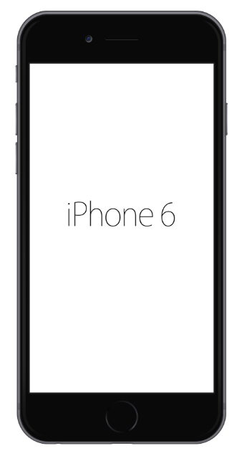
Window
See where your style takes you
Problem
Process
Shopping is frustrating when you spend hours looking for clothes but don’t like what you see.
Needfinding Interviews
Low-Fi Prototype
Design
Iteration
Evaluate
Prototype
Using augmented reality, we place a custom mannequin in the storefront window showcasing what’s in stock so you can easily view what a store has to offer. Spend your time on what matters to you.
High-Fi Prototype
Med-Fi Prototype
Features
Quick Details
Simple Filtering
Sharing with Friends
http://hci.stanford.edu/courses/cs147/2016/au/projects/MixedReality/Window/
Max Freundlich
Kristen Law
Elisa Lupin-Jimenez
CS147 Autumn 2016

